Slide 1
Database Programming

Slide 2
1. Introduction
Persistent Storage
Basic Database Operations
  Underlying storage
  User interface
  Databases
  Components
  SQL
Databases and Python
  Multitiered communication between application and database

Slide 3
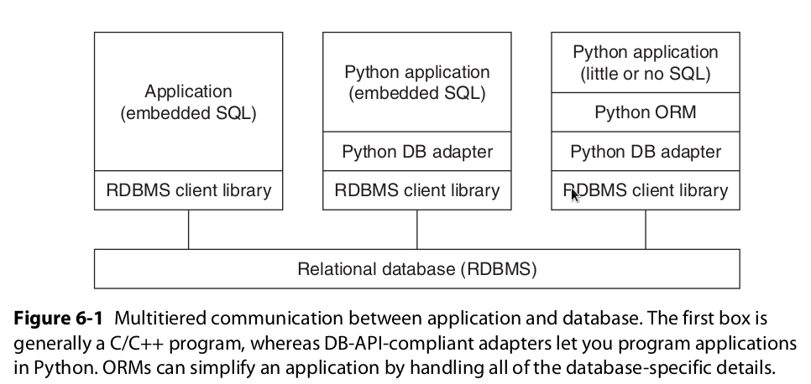
Introduction

Slide 4
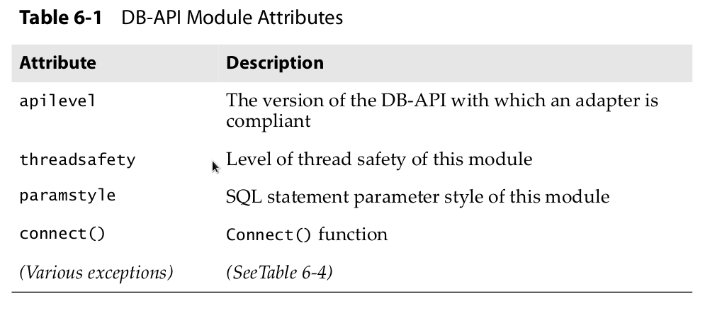
2. PythonDB - API
Module Attributes

Slide 5
2. PythonDB – API -Module Attributes
Apilevel- 1.0,2.0 etc
threadsafety-
    This an integer that can take the following possible values:
      0: Not threadsafe, so threads should not share the module at all
      1: Minimally threadsafe: threads can share the module but not connections
      2: Moderately threadsafe: threads can share the module and connections but not cursors
      3: Fully threadsafe: threads can share the module, connections, and cursors

Slide 6
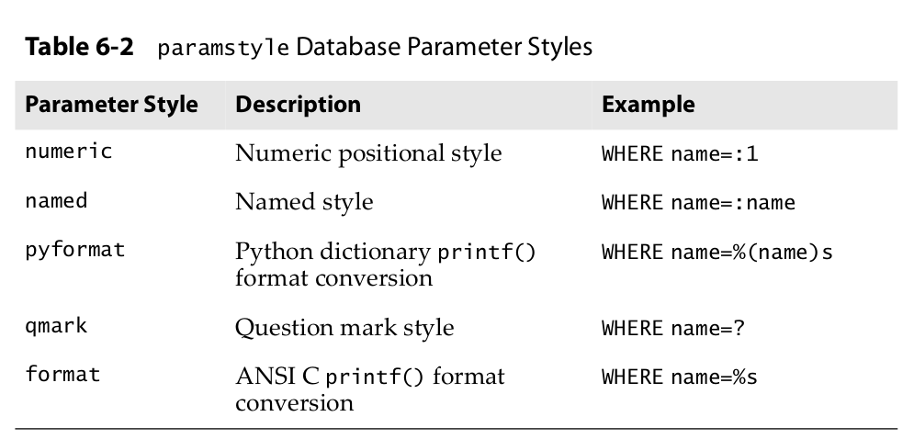
2. PythonDB – API -Module Attributes
Paramstyle - The API supports a variety of ways to indicate how parameters should be integrated into an SQL statement that is eventually sent to the server for execution. This argument is just a string that specifies the form of string substitution you will use when building rows for a query or command

Slide 7
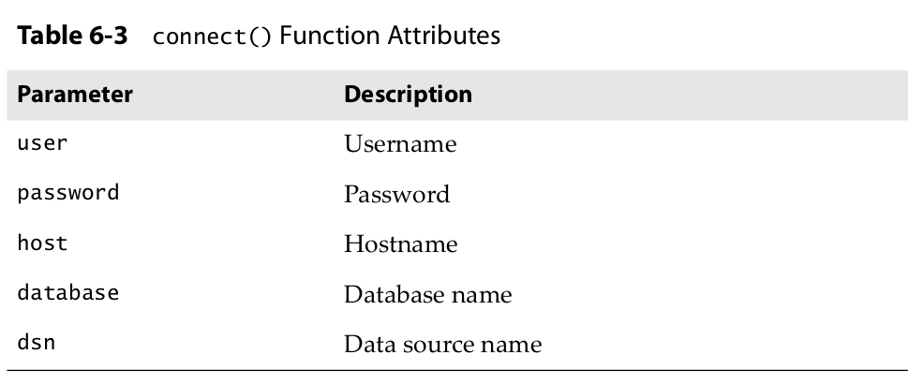
2. PythonDB – API -Module Attributes
Function Attribute(s)
  connect() Function access to the database is made available through Connection objects. A compliant module must implement a connect() function, which creates and returns a Connecion object. Table 6-3 shows the arguments to connect()
  connect(dsn='myhost:MYDB',user='guido',password='234$')

Slide 8
2. PythonDB – API -Module Attributes
Function Attribute(s)
  The following are some examples of non-DSN connect() calls. Note that not all adapters have implemented the specification exactly, e.g., MySQLdb uses db instead of database .
MySQLdb.connect(host='dbserv', db='inv', user='smith')
PgSQL.connect(database='sales')
psycopg.connect(database='template1', user='pgsql')
gadfly.dbapi20.connect('csrDB', '/usr/local/database')
sqlite3.connect('marketing/test')

Slide 9
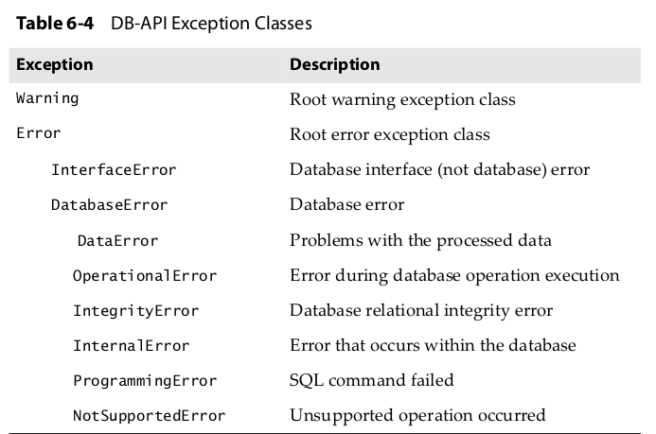
2. PythonDB – API -Module Attributes
Exceptions:

Slide 10
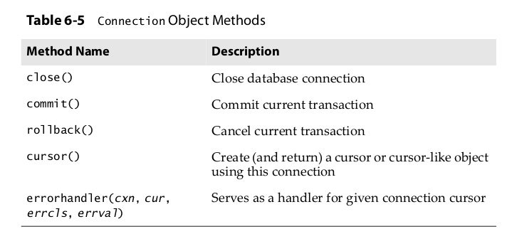
2. PythonDB – API -Connection Objects
Connection Object Methods:

Slide 11
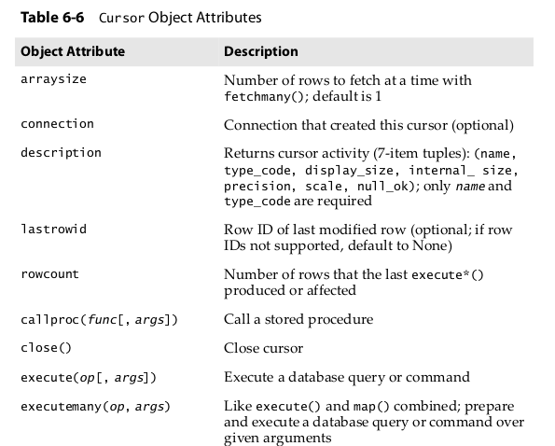
2. PythonDB – API -Connection Objects
Cursor Objects:

Slide 12
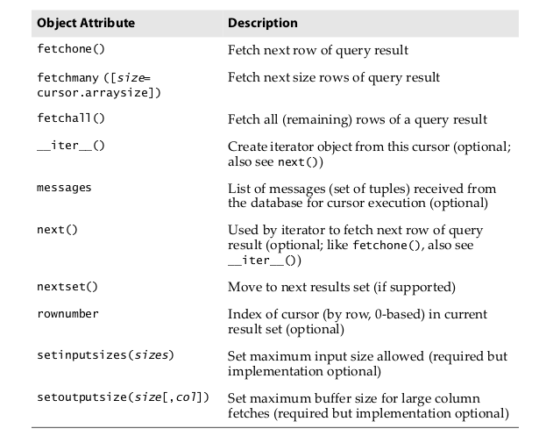
2. PythonDB – API -Connection Objects
Cursor Objects:

Slide 13
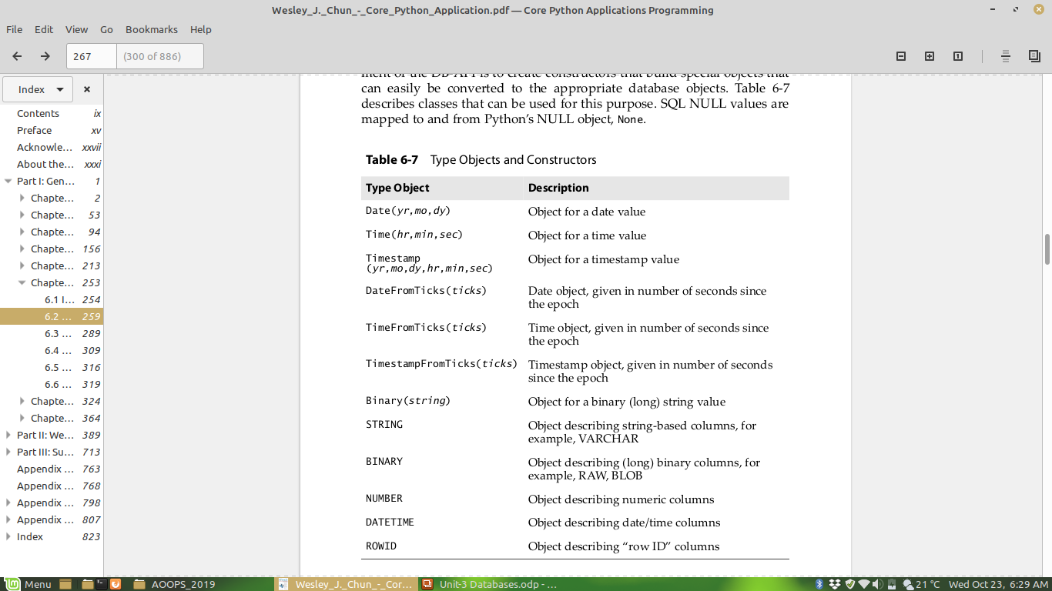
2. PythonDB – API -Connection Objects
Type Objects and Constructors:

Slide 14
2. PythonDB – API -Connection Objects
Examples of Using Database Adapters:
  MYSQL
>>> import MySQLdb
>>> cxn = MySQLdb.connect(user='root')
>>> cxn.query('DROP DATABASE test')
Traceback (most recent call last):
File "<stdin>", line 1, in ?_mysql_exceptions.OperationalError: (1008, "Can't drop, database 'test'; database doesn't exist")
>>> cxn.query('CREATE DATABASE test')
>>> cxn.query("GRANT ALL ON test.* to ''@'localhost'")
>>> cxn.commit()
>>> cxn.close()

